Slide 1
BeNow - established in 2001
Eva Søgnebotten, CEO and co-founder
VISION:
Every women can be a leader Every woman can make a difference in the world
“Never doubt that a small group of thoughtful, committed citizens can change the world; indeed, it’s the only thing that ever has.”
Margaret Mead

Slide 2
MISSION:
Inspire, encourage and support women to go where they naturally belong:
with presence and participation in business, politics and society in realm of female leadership.

Slide 3
Eva:
Family & Home
Married,
Mother of three grown up children aged 21, 26 and 29.
Live on a farm at the countryside, only 6 km from the railwaystation
that takes me by train to Oslo airport in 45 minutes
and to Oslo a little bit longer.

Slide 4
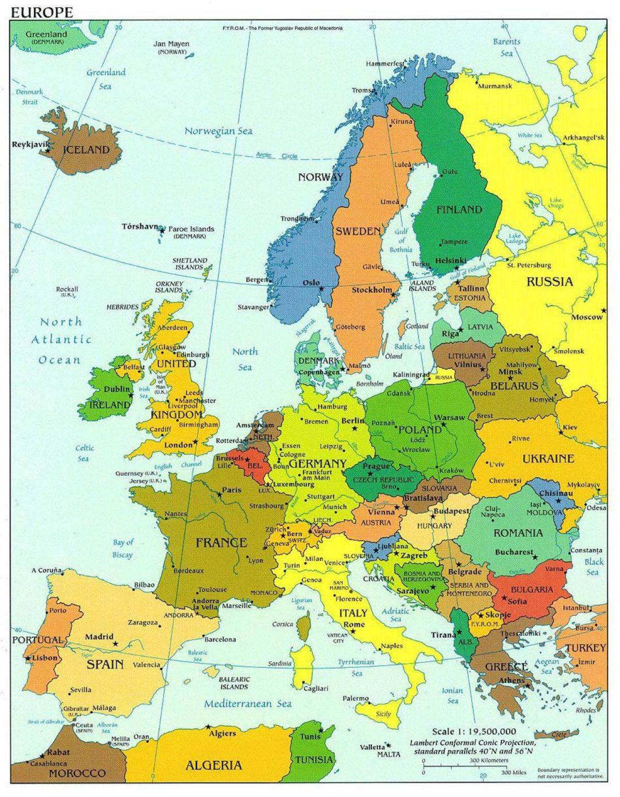

Slide 5
Eva Søgnebotten, CEO and founder of BeNow
Since 2007, engaged and focused on womens participation and presence in business, politics and society in different ways locally, nationally and internationally.
Formal background: Lawyer (master in law) from University of Bergen Market oriented process management, Norwegian Business School Competence in board work, Norwegian Business School Certified Co-active coach, The Coaches Training University, Florida Norwegian Municipality sector & EU/EEA, in theory and prac., KS Pedagogical education, University of South-Eastern Norway

Slide 6
Political experience (besides running www.benow. no)
2011 - 2015 Deputy Mayor in Stange Municipality (21.000 residents)
2015 - 2019 Political leader, The permanent plan committee in Stange Municipality, Norway

Slide 7
www.benow.no
offers services specially designed for groups and individual female
entrepreneurs, leaders in business and politics,
Such as: individual coaching and mentoring, leadership support
designed workshops, teambuilding and development and processes, programs and lectures.
This also includes many years international work and engagement
To be a leader could be a role,
Leadership is a choice!

Slide 8
International work – page 1
2018-2020 How to deal with Master Suppression Techniques? Strategic partner in Erasmus+ - Aiming at female politicians and your girls, involving organizations in Check Republic and Poland. (Master Suppression Techniques are orginated from Norway)
2014–2016 Political mentor in the project “Give women a Chance” in The Czech Republic. The purpose: to promote and support women in politics in the Czech Republic. Funded by Norway Grants through the NGO Forum 50%, in partnership with Nordic Chamber of Commerce.
2014-2015 Political mentor in EEA project in Hungary The purpose: to motivate, understand and implement increasing female participation in politics and public life.

Slide 9
International work – page 2
- Study stay in Brussels, Oslo region European Office
The aim: to get more familiar with the EU institution, and in particular women`s positions in politics, business and society.
2013 – Leading the Voting Rights Committee
The celebrating 100th anniversary. Several events and a anniversary booklet was published.
2008 – Workshop – Women Can Do It! - South of Sudan, Upper Nile State
Leading workshops training in this concept to mobilize locale female politicians to secure continuations of female political engagement and participation, together with Norwegian People Age.

Slide 10
NORWAY
NORWEGIAN CULTURE AND VALUES:
http://travelguide.nettavisen.no/42-things-every-foreigner-must-learn-about-norway/
https://en.wikipedia.org/wiki/Norway
https://en.wikipedia.org/wiki/Culture_of_Norway

